Slide 1
Secure Data Hiding in Image Using Steganography
CAPSTONE PROJECT
Presented By: Guduru Suneetha
Student Name : Guduru Suneetha
College Name & Department : Chadalawada Ramanamma Engineering college , MCA

Slide 2
Table of contnets
Problem Statement
Technology used
Wow factor
End users
Result
Conclusion
Git-hub Link
Future scope

Slide 3
Problem Statement
The problem statement for Secure Data Hiding in Image Using Steganography typically revolves around the need to embed secret messages within images in a way that maintains the visual integrity of the images and ensures that the hidden data can only be accessed by authorized users.
The main goals are:
Concealment: Ensuring the hidden data is not perceptible to unintended recipients.
Integrity: Maintaining the quality and appearance of the carrier image.
Security: Protecting the hidden data from unauthorized access or detection.
Efficiency: Embedding data without significantly increasing the size of the image.

Slide 4
Technology used
The technology used for Secure Data Hiding in Image Using Steganography typically involves several key components:
Image Processing Libraries: Tools like OpenCV is commonly used for handling image data.
Encryption Algorithms: To ensure the hidden data is secure, algorithms like AES (Advanced Encryption Standard) are often employed.
Steganography Techniques: Techniques such as Least Significant Bit (LSB) modification are used to embed the hidden data within the image.
User Interface: Libraries like Tkinter or customtkinter are used to create a Graphical User Interface (GUI) for easy interaction with the steganography tool.
Web-based Interface: For web applications, frameworks like Streamlit can be used to create an interactive web UI.

Slide 5
Wow factors
They are some wow factors in steganography:
Invisibility: The hidden data doesn't alter the visual appearance of the image, making it undetectable to the naked eye.
Security: Only authorized users with the correct key or password can access the hidden information.
Versatility: It can be applied to various types of media, including images, audio, and video.
Innovative Applications: Beyond just hiding data, steganography can be used in creative ways like creating mystery puzzles or cyber-escape challenges.
Technological Integration: Combining steganography with other technologies like encryption enhances the security of hidden data.

Slide 6
End users
End users for a Secure Data Hiding in Image Using Steganography project can span a wide range of fields and purposes. Here are some examples:
Journalists and Whistleblowers: To securely transmit sensitive information without detection.
Government Agencies: For secure communication and data transfer in classified operations.
Corporate Entities: To protect intellectual property and sensitive communications.
Individuals: For personal data protection and privacy.
Healthcare Providers: To securely store and transfer patient information and medical records.
Law Enforcement: To covertly share information related to investigations.
Academics and Researchers: To hide and share confidential research data.
Military: For secure communication in operations and intelligence sharing.
Artists and Designers: To embed copyright information and signatures in their digital works.

Slide 7
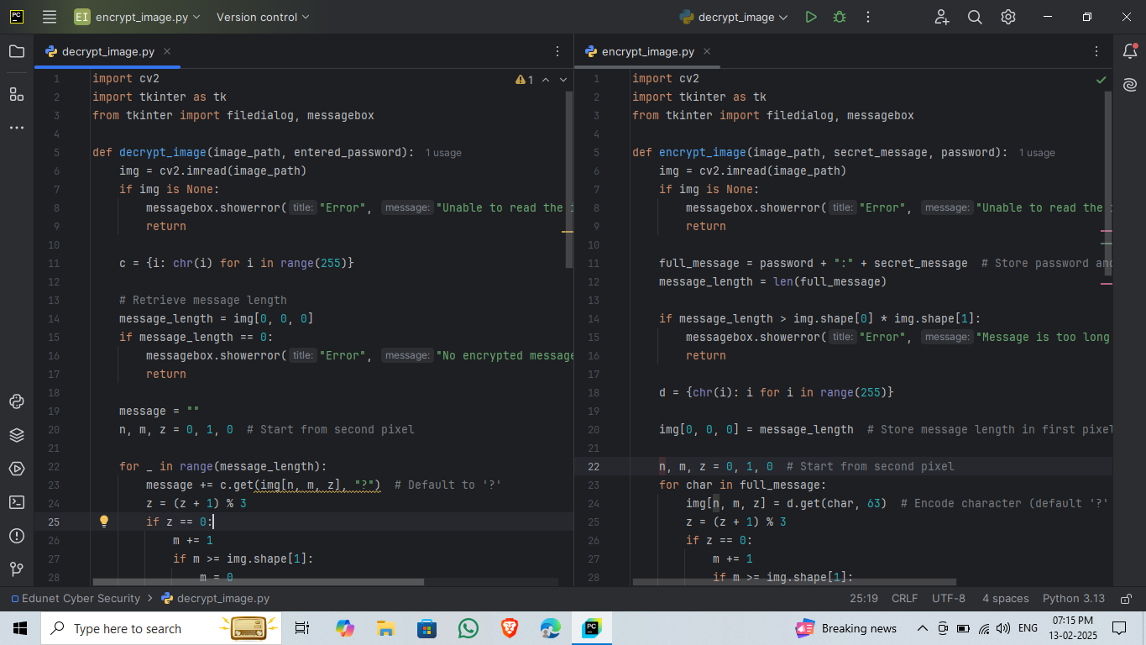
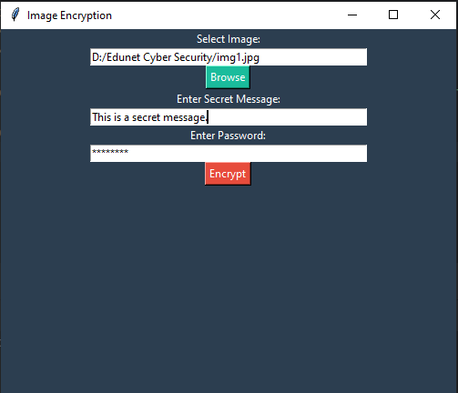

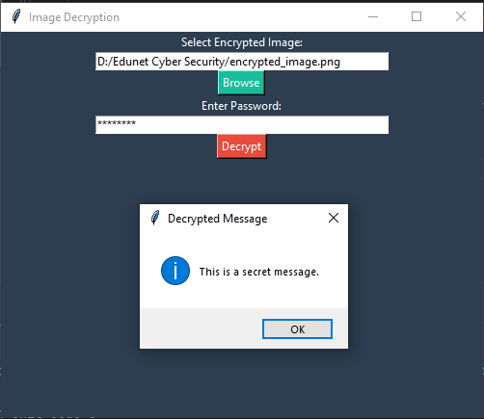
Results

Slide 8
Conclusion
In This conclusion is a, Secure Data Hiding in Image Using Steganography provides an innovative and effective method for embedding sensitive information within digital images. This technique ensures that data remains hidden and secure, while maintaining the visual quality of the carrier image.
The key advantages include:
Confidentiality: Protects sensitive information from unauthorized access.
Integrity: Maintains the visual quality of the image, ensuring minimal distortion.
Security: Utilizes encryption and advanced steganographic techniques to enhance data protection.
Versatility: Can be applied across various fields, such as journalism, government, healthcare, and personal privacy.
Scalability: Capable of handling different image formats and varying amounts of data.
These are some implementing and continuously improving upon these techniques, we can achieve higher levels of data protection and privacy in our increasingly digital world.

Slide 9
GitHub Link
https://github.com/startmycarrier/My-project.git

Slide 10
Future scope(optional)
These are the future scope for Secure Data Hiding in Image Using Steganography:
Advanced Encryption: Incorporating sophisticated encryption methods, such as quantum cryptography.
AI and Machine Learning: Using AI to enhance the efficiency and stealth of data embedding.
High-Resolution Media: Expanding capabilities to high-resolution images and videos.
Real-Time Applications: Developing systems for live video streams.
Cross-Disciplinary Use: Applying steganography in digital forensics, IoT, and medical imaging.
Emerging Tech: Exploring applications in VR and AR environments.
Authentication: Using steganography for digital watermarking and content authentication.
User-Friendly Tools: Creating more accessible and intuitive steganographic tools.
Legislation: Establishing legal frameworks for ethical use.

Slide 11
THANK YOU

